Slide 1


INTRODUCTION TO OPEN SOURCE AND GIT

Slide 2
What Is Version Control?
Version control systems are a category of software tools that help a software team manage changes to source code over time.
keeps track of every modification to the code in a special kind of database.
If a mistake is made, developers can turn back the clock and compare earlier versions of the code to help fix the mistake while minimizing disruption to all team members.

Slide 3
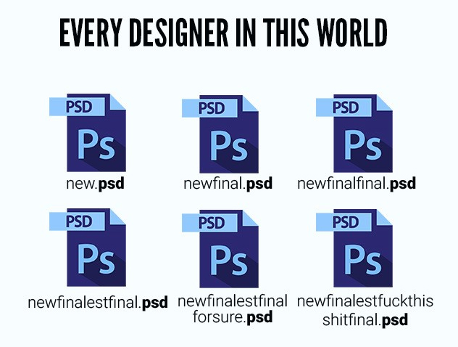
WHY VCS?

Slide 4
-labels changes through messages.
-allows switches between different versions.
-allows merging different versions.
-compares the versions.

Slide 5
Localised and Centralized VCS
A localized version control system keeps local copies of the files. This approach can be as simple as creating a manual copy of the relevant files.
Centralized VCS stores the different versions on a central server, which can be copied to the local system.(a particular code is locked so that only 1 developer can work on it.) Eg- CVS, Subversion
Both don’t provide the facility to work in parallel.

Slide 6
DISTRIBUTED VCS
Codebase is distributed among various developers(peer to peer model)
Multiple users can work in parallel.
Changes are made to the local copies and merged with the central copy.
Example- Git

Slide 7
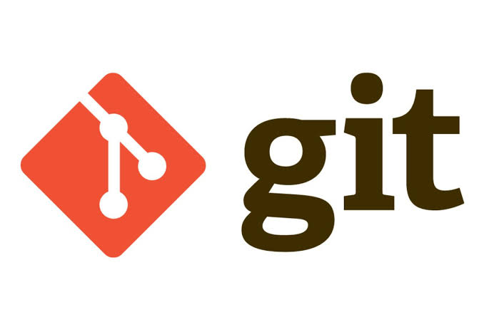
GIT
Most popular distributed vcs.
Founded by Linus Torvalds.

Slide 8
Terminology
Repository: A repository contains the history, the different versions over time and all different branches and tags.
Commit(snapshot): When you commit your changes into a repository this creates a new commit object in the Git repository. This commit object uniquely identifies a new revision of the content of the repository.

Slide 9
Staging area: A ﬁle in the Git directory that stores information about what will go into your next commit. It is like a prep table before the files go into the repo.
Branch: A branch is when a new line of development is created that diverges from the main line of development. This alternative line of development can continue without altering the main line.
Checkout: Switching between branches is called ‘checking out’.
Merge: Merging code from different branches.
Push: Adding the local repository code to the remote repo.

Slide 10
